Slide 1
Agenda
Welcome and introductions- Chair Council Member Julie Mullica
Approval of January 23 NATA Meeting Minutes
Smart Commute update: Carson Priest, Tammy Herreid
Transportation Safety Grant pursuit –focus on education for older adult drivers
Update on DRCOG Data Reporting Subcommittee
Summer outreach/health and wellness fairs
CDOT Transportation Commission update- TC Vice Chair Karen Stuart
Funding formulas
10 year project pipeline list
Update on Homeless Camp (I-25 / I-76 clean-up)
NATA Orientation update- staff
Status of action items
Major projects list amendments process
2020 Focus
RTD Directors Comments and discussion with NATA:
N-Line Completion Challenges
HB-151
Reimagine RTD- NATA request to pause
Comments by RTD Interim General Manager Paul Ballard
Other

Slide 2
CDOT RPP Formula
Program Goal: Flexible funding for regional priority projects
Program Funding: ~$50M annually
Program Overview:
State Discretion
Funded through annual Transportation Commission allocation
Distribution formula agreed upon by MPOs, TPRs, CDOT, FHWA and FTA
Prior Methodology
Distribution based on 50% Population / 35% Lane Miles / 15% Truck VMT

Slide 3
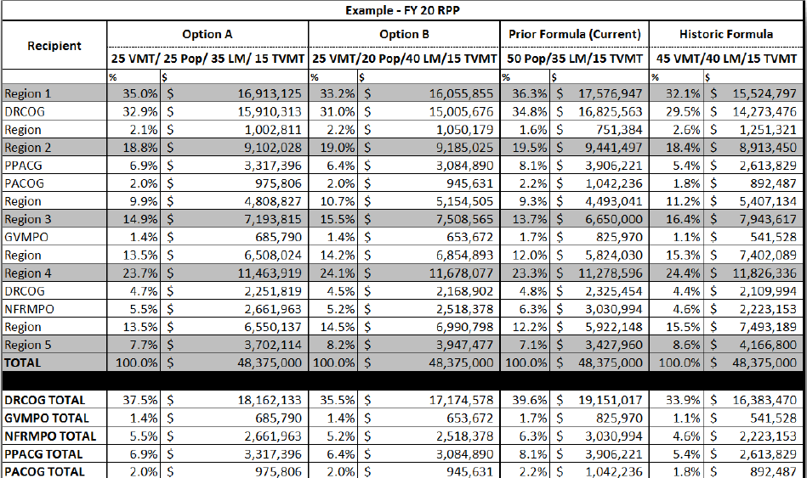
CDOT RPP Formula

Slide 4
CDOT 10-Year Pipeline: Background
Develop project lists covering all the out years of the Strategic Pipeline of Projects (years 5-10)
Use a fiscally constrained target of an additional $500M per year (above the base program) for the six out years of the pipeline (years 5-10)
10 percent to Transit
10 percent of the 10 percent to Transit dedicated to Statewide Bustang expansion
Same parameters as SB267 projects (first four years of pipeline)
Lists developed with planning partners using these inputs (public input, TC guiding principles, funding parameters)

Slide 5
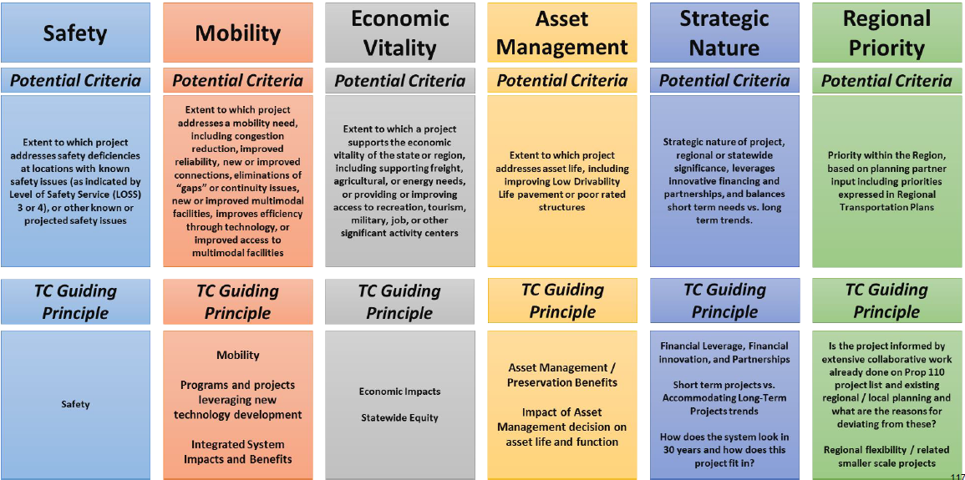
TC Guiding Principles & Criteria

Slide 6
Integration with Statewide Plan
10 Year Strategic Pipeline of Projects is one component of overall planning document
Includes elements required by state/federal statutes
Includes 10 rural Transportation Planning Region plans
Includes all the projects that were identified in planning process, but not included in the 10-Year Strategic Pipeline of Projects

Slide 7
Integration with Statewide Plan

Slide 8
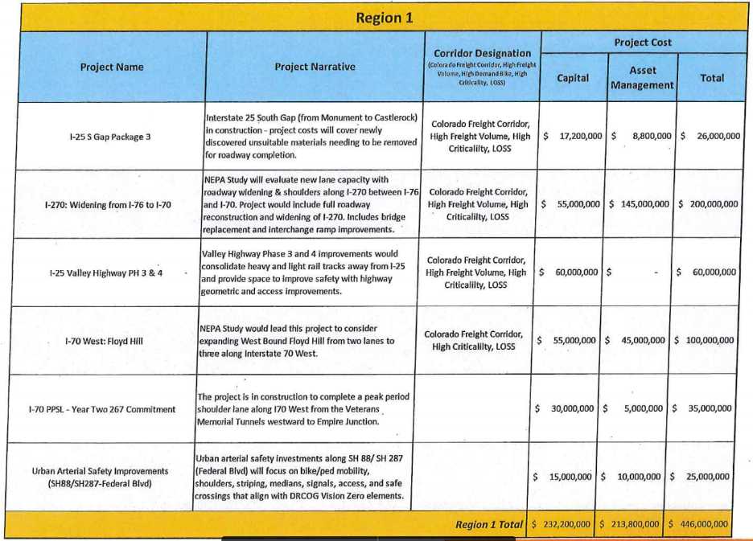
Region 1 Highway Yrs. 1-5

Slide 9
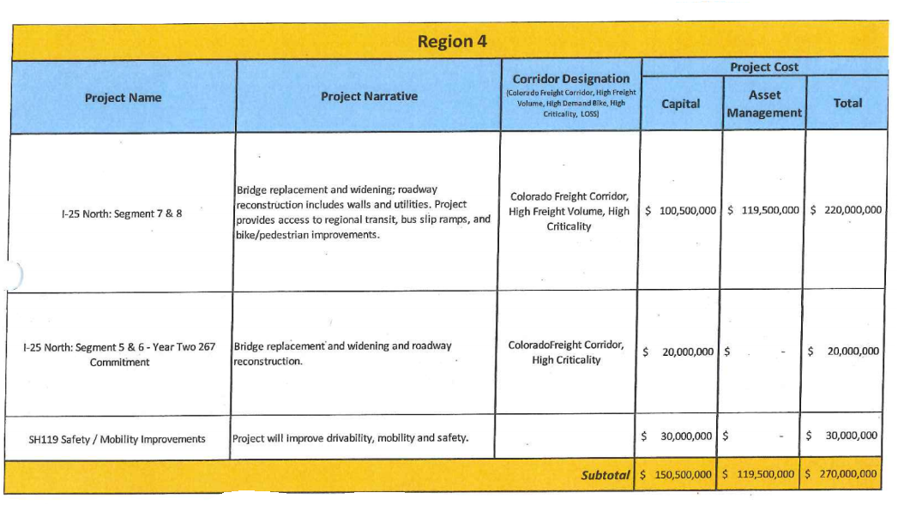
CDOT 10-Year Pipeline Project List
Region 4 Highway Yrs. 1-5

Slide 10
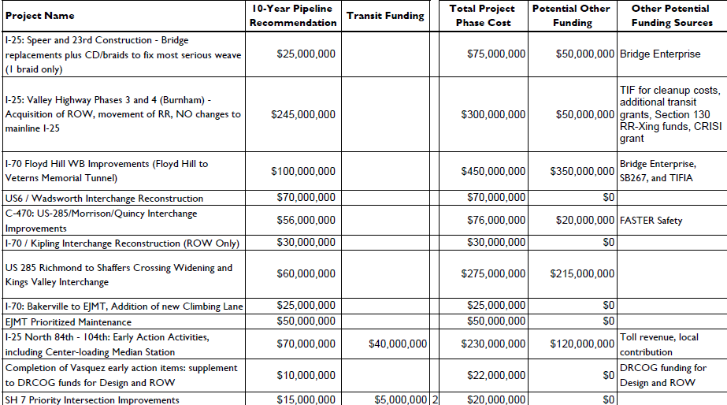
CDOT 10-Year Pipeline Project List
Region 1 Highway Yrs. 6-10

Slide 11
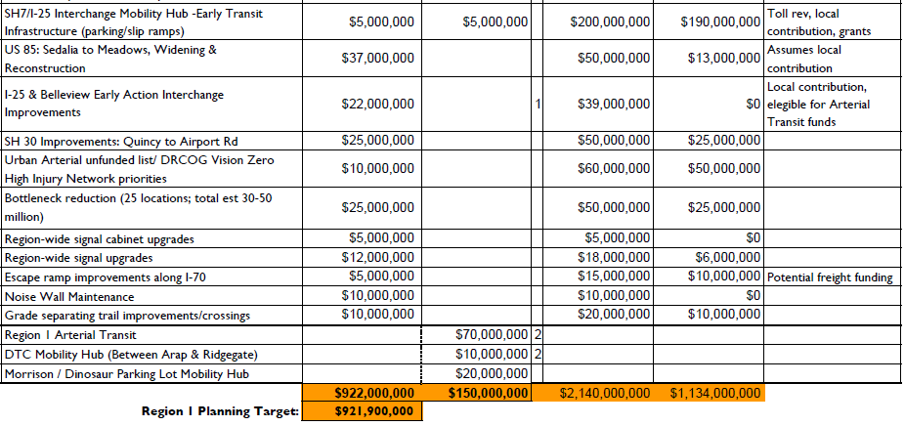
CDOT 10-Year Pipeline Project List
Region 1 Highway Yrs. 6-10

Slide 12
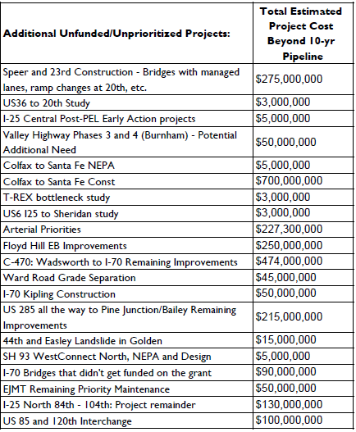
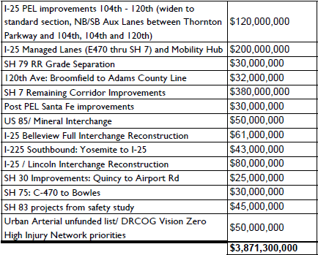
CDOT 10-Year Pipeline Project List
Region 1 Un-prioritized Yrs. 6-10

Slide 13
CDOT 10-Year Pipeline Project List
Region 4 Highway Yrs. 6-10
Project Name | Project Description | TPR / MPO | Years 5-10 Pipeline
SH7 Boulder to Brighton | Construct Operational, intersection and safety improvements to connect communities for work, school and play | DRCOG | $9,000,000
SH119 BRT / Managed Lanes | Construct Operational, intersections, transit and safety improvements | DRCOG | $20,000,000
Region 4 Transit Yrs. 6-10
Project Name | Project Description | TPR / MPO | Years 5-10 Pipeline
SH7 Boulder to Brighton | Construct transit related operational, and safety improvements | DRCOG | $6,300,000
SH119 BRT / Managed Lanes | Construct transit related operational, and safety improvements | DRCOG | $4,880,000

Slide 15
,

Slide 16
NATA Orientation Retreat In Review
February 27, 2020

Slide 17
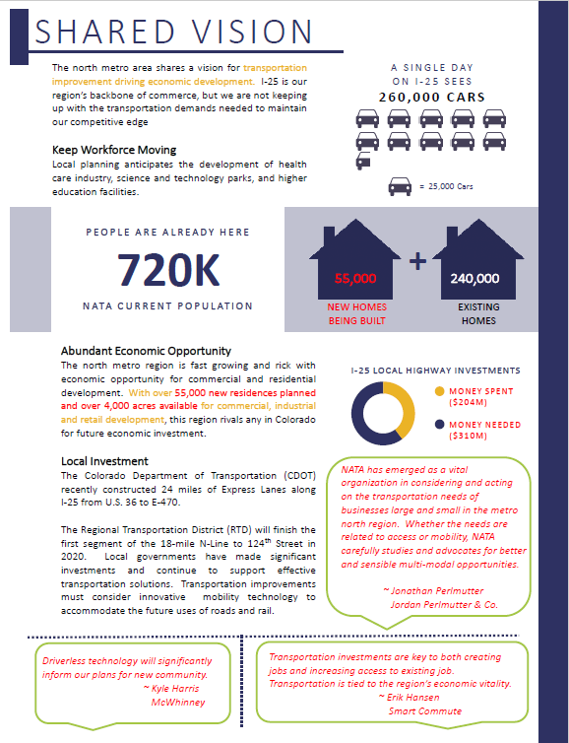

Slide 18
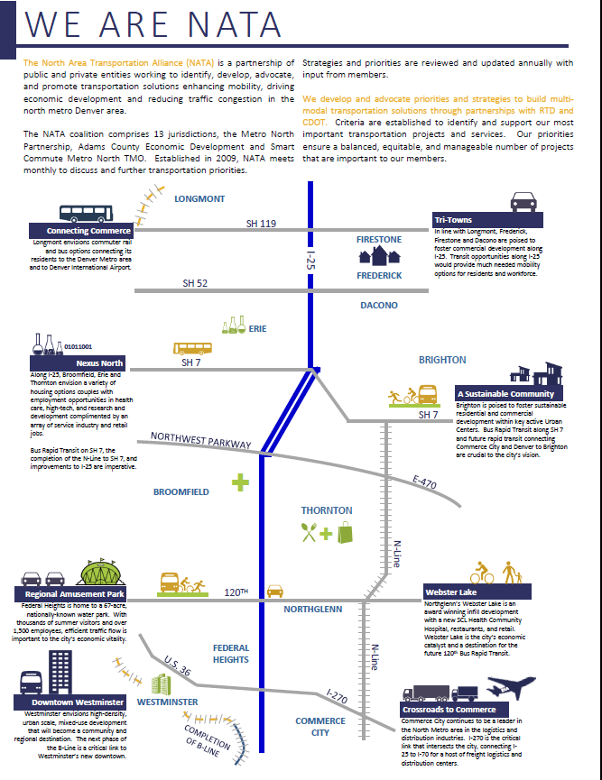
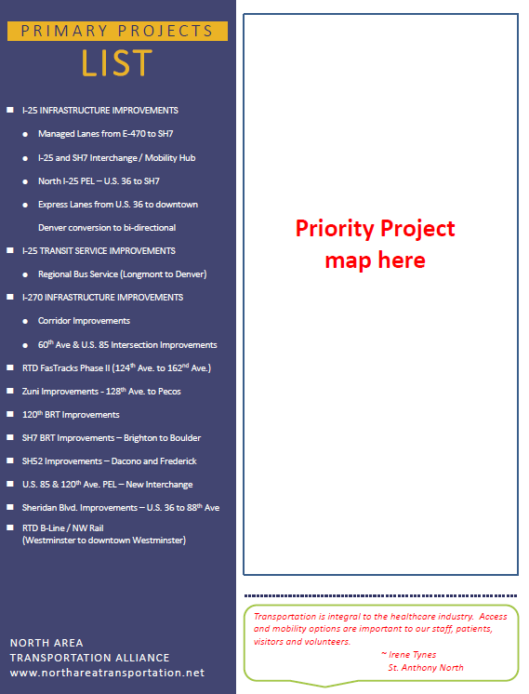

Slide 19
Next Steps
Local investment stats
Customized jurisdictional snapshot
Reevaluate Master Project List Updates in March

Slide 20
Transportation 101

Slide 21
Transportation 101

Slide 22
Transportation 101

Slide 23
Transportation 101

Slide 24
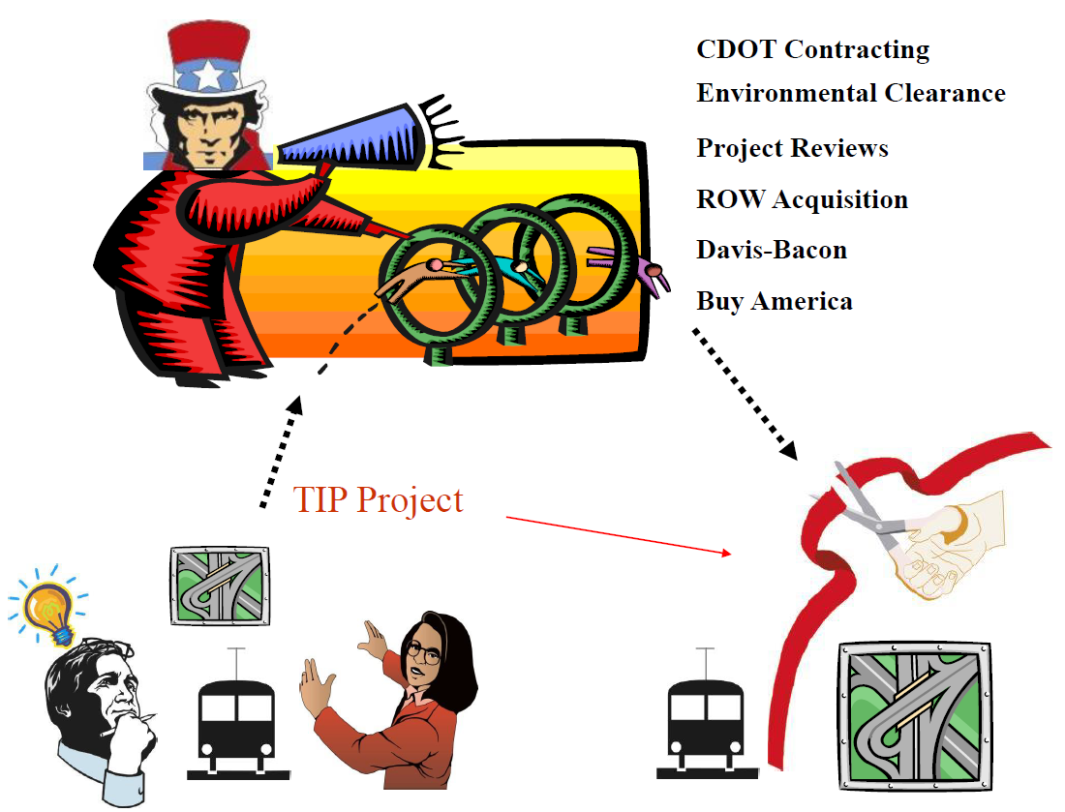
Transportation 101

Slide 25
2020 Focus
Suggested Series of Subcommittees
Review and Update of Master Project List
Improving NATA’s Communication
Update Transportation Connections Handout
Transportation 101 Video(s)
Looking to the future

Slide 26
Agenda
Welcome and introductions- Chair Council Member Julie Mullica
Approval of January 23 NATA Meeting Minutes
Smart Commute update: Carson Priest, Tammy Herreid
Transportation Safety Grant pursuit –focus on education for older adult drivers
Update on DRCOG Data Reporting Subcommittee
Summer outreach/health and wellness fairs
CDOT Transportation Commission update- TC Vice Chair Karen Stuart
Funding formulas
10 year project pipeline list
Update on Homeless Camp (I-25 / I-76 clean-up)
NATA Orientation update- staff
Status of action items
Major projects list amendments process
2020 Focus
RTD Directors Comments and discussion with NATA:
N-Line Completion Challenges
HB-151
Reimagine RTD- NATA request to pause
Comments by RTD Interim General Manager Paul Ballard
Other

