Slide 1
Agenda
7:30 am
Welcome and introductions- Chair Council Member Julie Mullica
Approval of February 27th NATA Meeting Minutes (Sent to NATA reps 4/23)
Introduction of the Adams County Regional Economic Partnership (ACREP) - Bo Martinez, President and CEO
7:40 am
Smart Commute update: Carson Priest, Tammy Herreid
Work Plan Update: Pre-COVID, current COVID
"5 Tips" videos, webinars
144th FlexRide, Uber Rides, EasyMile
Update on Leave Behind, Priority Projects List
7:50 am
CDOT Transportation Commission update- TC Vice Chair Karen Stuart
Statewide Transportation Plan
Budget implications for 10-year project pipeline list
Segment 3 Managed Lanes Tolling start-up
8:00 am
RTD Directors Comments – Director Vince Buzek, Director Troy Whitmore
N-Line update
Legislative Update
8:15 am
CDOT Update
1-270 – Adam Parks
1-25 EA – Postponed until June meeting
8:30 am – 9:15 am
The Future of Clean Mobility Presentation – Sophie Shulman, CDOT Office of Innovative Mobility
Other
Chair Mullica, on behalf of NATA, will send a letter to RTD supporting retention of FISA funds for the construction of unfinished FasTracks Corridors.
Please sign in using the chat box

Slide 2
2020 Work Plan
North Metro Bike Network Map
N-Line Station Area Parties
8th Annual TransForum around N-Line opening
ACT Conference Planning and Support
Outside Presentations for SCMN Board
Focus on Health and Wellness Fairs
On the topics of mobility, air quality and health
Jurisdictional Council Presentations
Partnership with Metro North Partnership (Chamber), ACED, Broomfield Chamber & SWEEP
Notes:
- This was our work plan Before COVID, or BC...

Slide 3
2020 B.C. Work Plan
North Metro Bike Network Map
N-Line Station Area Parties
??? 8th Annual TransForum around N-Line opening ???
??? ACT Conference Planning and Support ???
Outside Presentations for SCMN Board
Focus on Health and Wellness Fairs
On the topics of mobility, air quality and health
Jurisdictional Council Presentations
Partnership with Metro North Partnership (Chamber), ACED, Broomfield Chamber & SWEEP

Slide 4
2020 P.C. Work Plan
COVID-19 Response
Fast-Response Teleworking Tips Email (3/14)
Teleworking Best Practices Webinar (4/3)
Telework Tomorrow
Renewed Focus on Membership
Work with DRMAC and Uber to provide rides for essential workers
Work with EasyMile to determine best use of autonomous shuttle to deliver essential goods
North Metro Bike Network Map
8th Annual TransForum around N-Line opening
Enhancing Resource Information on Website

Slide 5
"5 Tips" Videos
https://www.youtube.com/watch?v=JDOEoKxpPPY&feature=youtu.be
https://www.youtube.com/watch?v=8TLo9cPpvjg&feature=youtu.be

Slide 6
Agenda
7:30 am
Welcome and introductions- Chair Council Member Julie Mullica
Approval of February 27th NATA Meeting Minutes (Sent to NATA reps 4/23)
Introduction of the Adams County Regional Economic Partnership (ACREP) - Bo Martinez, President and CEO
7:40 am
Smart Commute update: Carson Priest, Tammy Herreid
Work Plan Update: Pre-COVID, current COVID
"5 Tips" videos, webinars
144th FlexRide, Uber Rides, EasyMile
Update on Leave Behind, Priority Projects List
7:50 am
CDOT Transportation Commission update- TC Vice Chair Karen Stuart
Statewide Transportation Plan
Budget implications for 10-year project pipeline list
Segment 3 Managed Lanes Tolling start-up
8:00 am
RTD Directors Comments – Director Vince Buzek, Director Troy Whitmore
N-Line update
Legislative Update
8:15 am
CDOT Update
1-270 – Adam Parks
1-25 EA – Postponed until June meeting
8:30 am – 9:15 am
The Future of Clean Mobility Presentation – Sophie Shulman, CDOT Office of Innovative Mobility
Other
Chair Mullica, on behalf of NATA, will send a letter to RTD supporting retention of FISA funds for the construction of unfinished FasTracks Corridors.

Slide 7
N-Line Update
NORTH METRO RAIL LINE CIVIL CONSTRUCTION: WORK SCHEDULED FOR WEEK OF MAY 18-22, 2020
112TH AVENUE STATION​
Remove and replace non-compliant plaza pavement​
Strip Park-n-Ride and Bus loop​
Conduct ADA compliance verification for plaza and stairs​
124TH AVENUE STATION​
Finish grade parking area subgrade​
Place asphalt pavement​
Remove and replace non-compliant plaza pavement​
CORRIDORWIDE/STATIONS (ALL)​
Install landscaping and reseed for erosion and sediment control​
Continue punchlist work and general cleanup​
NATIONAL WESTERN CENTER STATION
Conduct ADA compliance verification for plaza and stairs
72ND AVENUE STATION
Conduct ADA compliance verification for plaza and stairs
Complete safe step pad installation and grading west of platform
88TH AVENUE STATION
Conduct ADA compliance verification for plaza and stairs
104TH AVENUE STATION
Continue site grading and seeding
Set Bus Shelters
Remove and replace non-compliant plaza pavement

Slide 8
N-Line Update
Ramp closure: The ramp from WB 74th Avenue to WB I-76 closed on April 27th to construct guideway protection barrier on RTD’s future N Line commuter rail that runs from Denver Union Station to the Eastlake 124th Station. A local detour will be in place for the duration of the barrier project that is scheduled for sixty days.

Slide 9
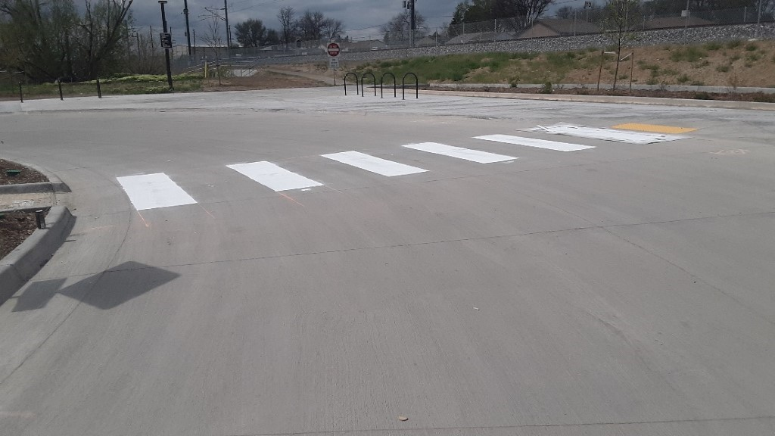
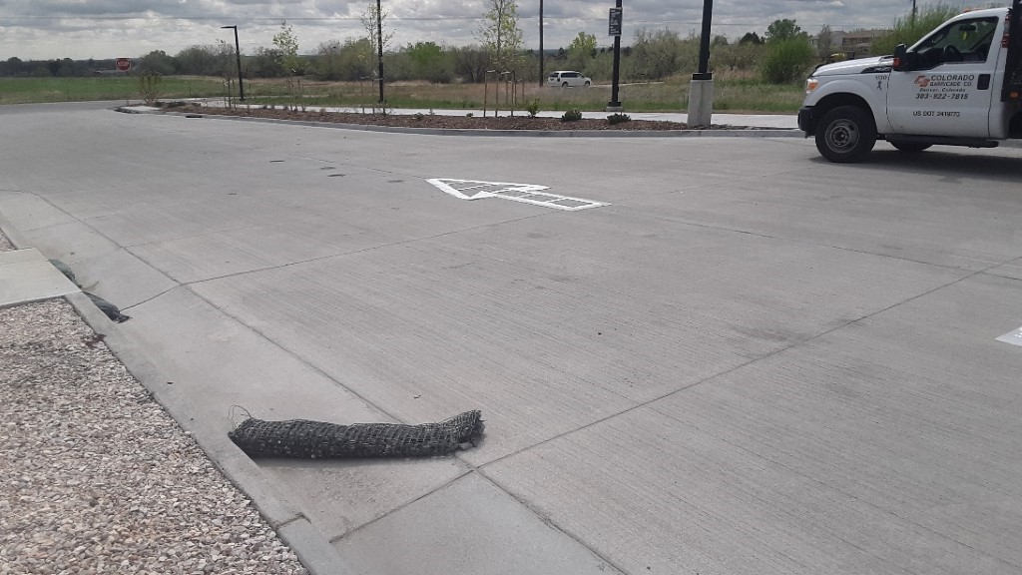
N-Line Update
Striping the bus loop at Northglenn 112th Station

Slide 10
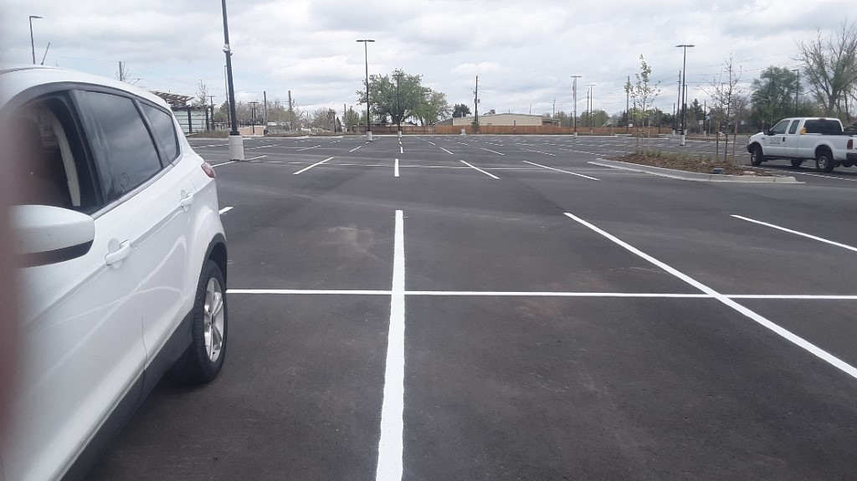
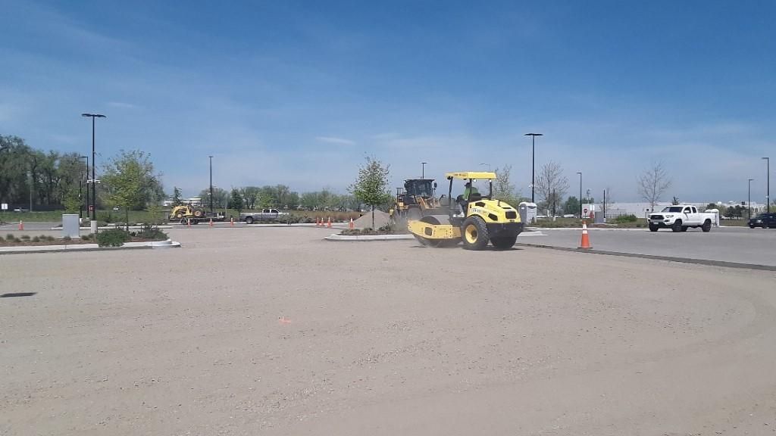
N-Line Update
Finish striping of Northglenn 112th Park-n-Ride
Preparing subgrade for asphalt paving at Eastlake 124th

Slide 11
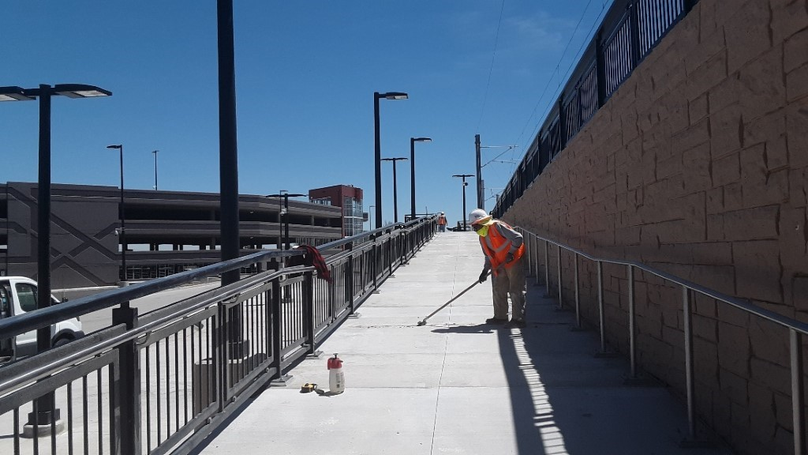
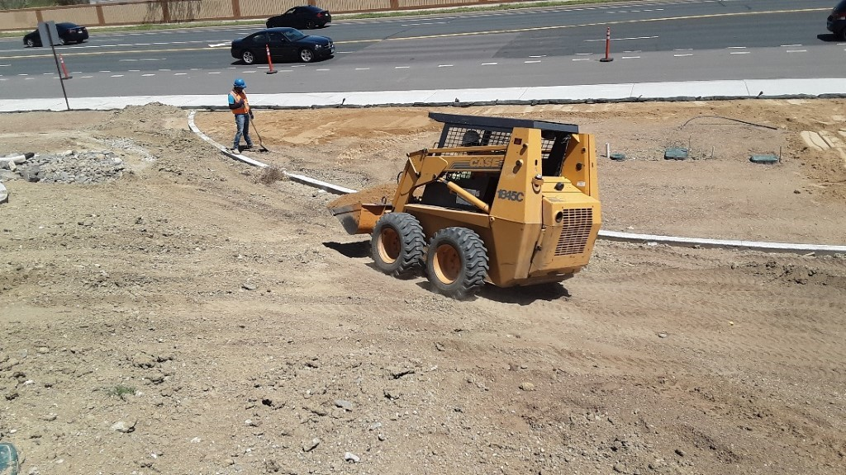
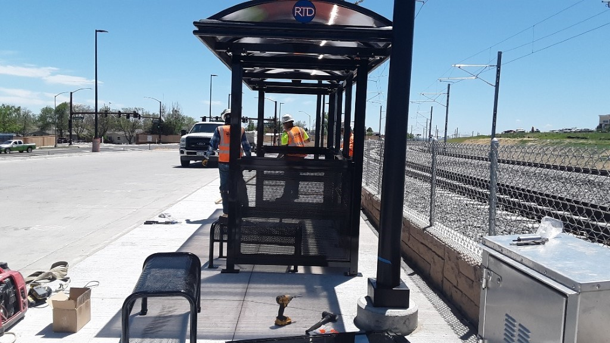
N-Line Update
Placing topsoil at Thornton Crossroads 104th parking structure
Saw cutting and sealing the ramp at Thornton Crossroads 104th Station
Installing bus shelters at Thornton Crossroads 104th Station

Slide 12
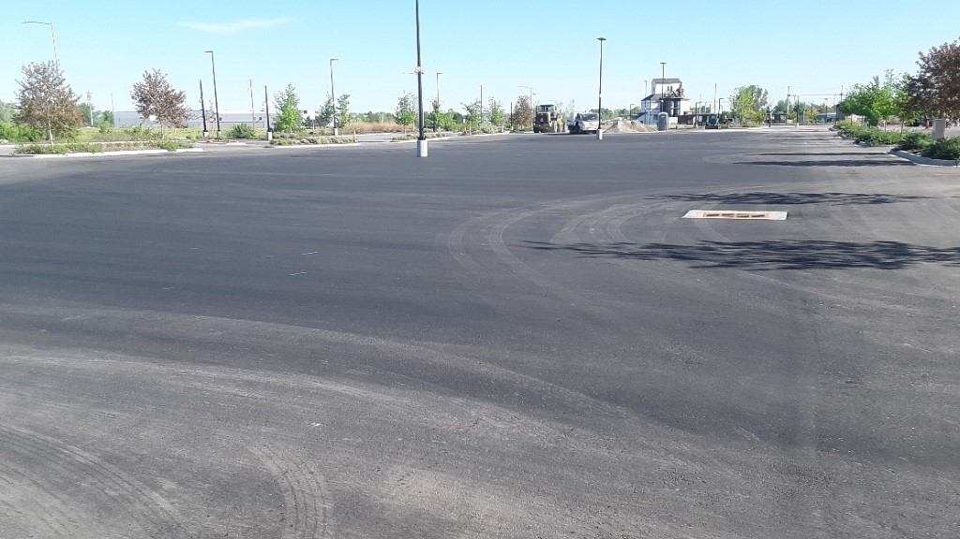
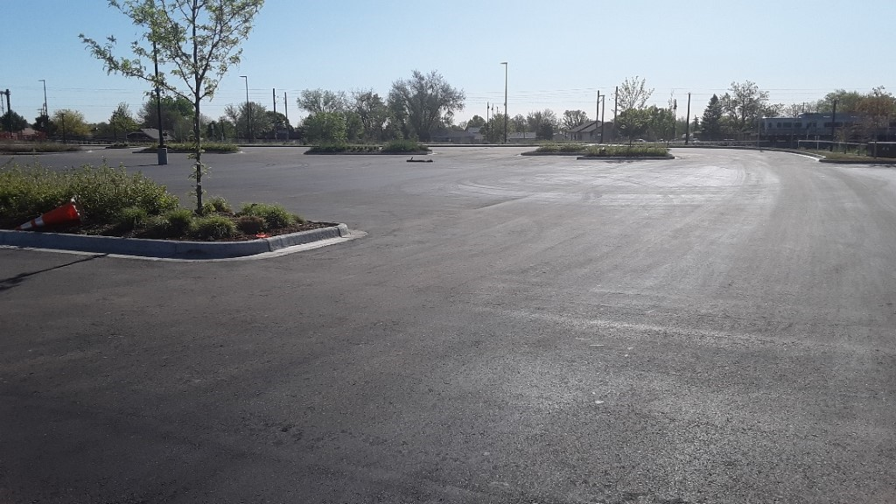
N-Line Update
Eastlake 124th Park-n-Ride asphalt paving completed

Slide 13
N-Line Update
NMRL SYSTEMS UPDATE:
Commuter rail operator training
Positive Train PTC and wireless crossing testing
Working to provide the FRA with a minimum of 30 days’ worth of grade crossing data for review and approval.
Maintenance of Way personnel are working to gain familiarization with track, overhead catenary and signal systems.
Traffic waits at a train crossing during testing for the future N Line commuter rail.

Slide 14
Agenda
7:30 am
Welcome and introductions- Chair Council Member Julie Mullica
Approval of February 27th NATA Meeting Minutes (Sent to NATA reps 4/23)
Introduction of the Adams County Regional Economic Partnership (ACREP) - Bo Martinez, President and CEO
7:40 am
Smart Commute update: Carson Priest, Tammy Herreid
Work Plan Update: Pre-COVID, current COVID
"5 Tips" videos, webinars
144th FlexRide, Uber Rides, EasyMile
Update on Leave Behind, Priority Projects List
7:50 am
CDOT Transportation Commission update- TC Vice Chair Karen Stuart
Statewide Transportation Plan
Budget implications for 10-year project pipeline list
Segment 3 Managed Lanes Tolling start-up
8:00 am
RTD Directors Comments – Director Vince Buzek, Director Troy Whitmore
N-Line update
Legislative Update
8:15 am
CDOT Update
1-270 – Adam Parks
1-25 EA – Postponed until June meeting
8:30 am – 9:15 am
The Future of Clean Mobility Presentation – Sophie Shulman, CDOT Office of Innovative Mobility
Other
Chair Mullica, on behalf of NATA, will send a letter to RTD supporting retention of FISA funds for the construction of unfinished FasTracks Corridors.

Slide 15
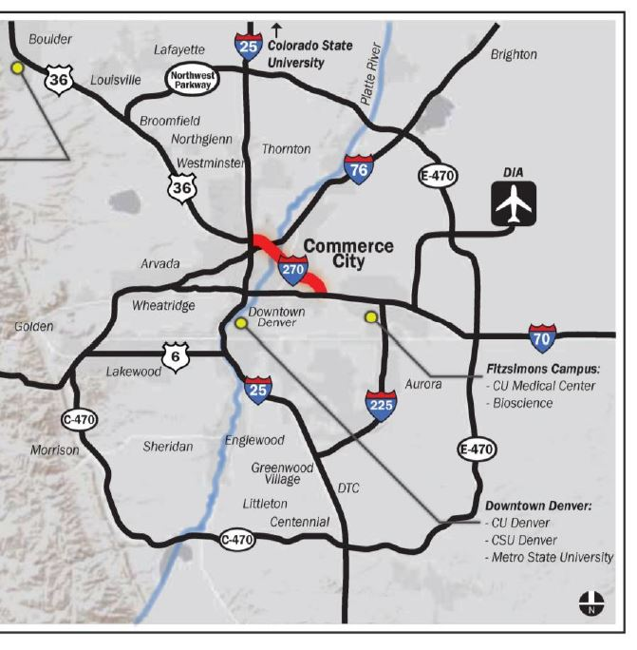
I-270 Corridor Improvements
Freeway Location:

Slide 16
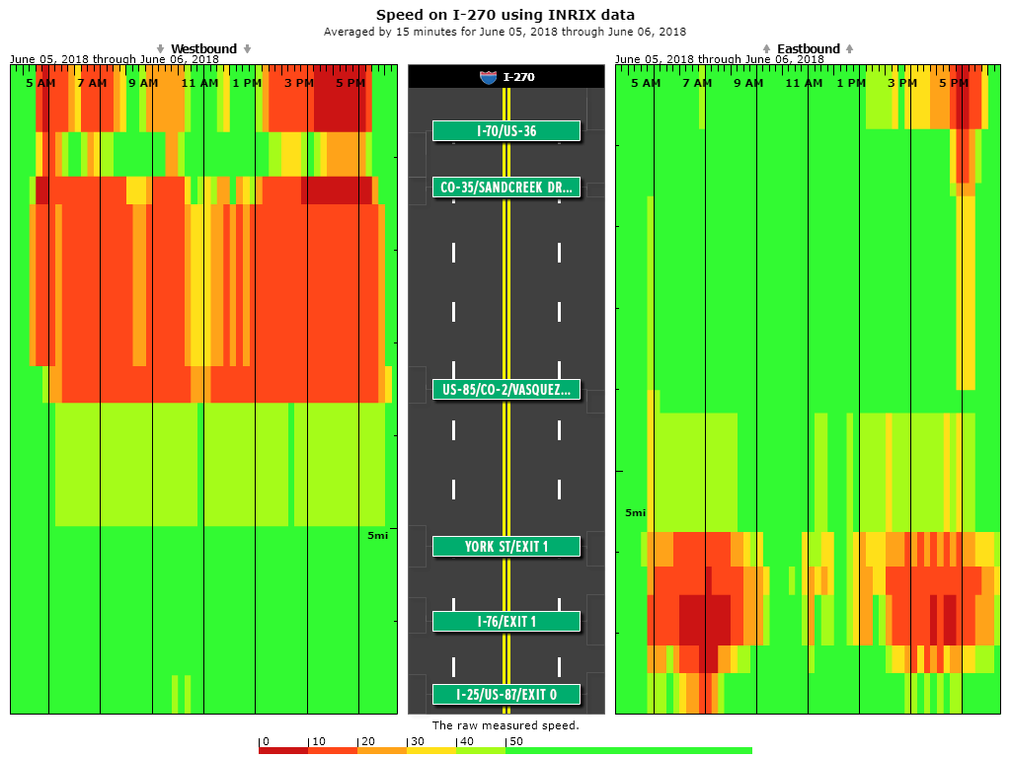
I-270 Corridor traffic congestion
Notes:
Most-congested freeway in Colorado
(based on hours of congestion per day)

Slide 17
I-270 Corridor - What has been done to date?
2014: TIGER grant application for I-270 corridor study (not granted)
2006-2018: Adjacent Central I-70 Central NEPA clearance
2018: I-270 Purpose & Need Workshop (CDOT & FHWA)
2019: HPTE/CDOT Express Lanes Master Plan
2019: I-270 Topographical Survey (Jacobs)
2019: I-270 Traffic Study (Atkins)
2019: I-270 HazMat and Historic Inventory Study (Pinyon, Mead and Hunt)

Slide 18
I-270 Corridor Improvements
Current phase: NEPA Environmental Assessment (EA)
April 2020 kick-off
Initiate public engagement in July
Preferred Alternative anticipated in late 2020
Decision Document in 2021
Summer 2020 field work crews mobilized:
Geotechnical soil samplings
Pavement cores
Hydrologic channel surveys

Slide 19
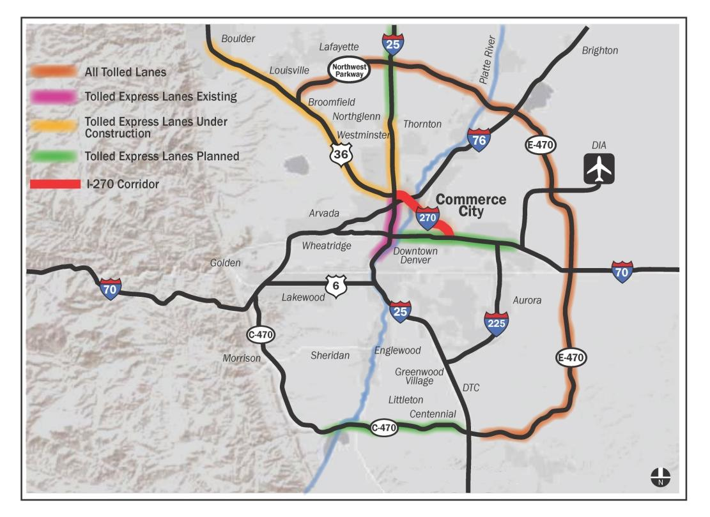
I-270 Corridor - What has been done to date?
HPTE Express Lanes Master Plan recommends I-270 as a Top Corridor for revenue generation:

Slide 20
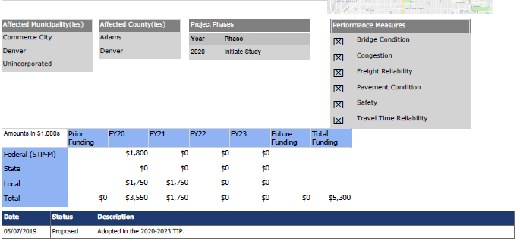
I-270 Corridor Improvements - Funding
Financial Contribution for Pre-Construction / NEPA
Commerce City
Adams County

Slide 21
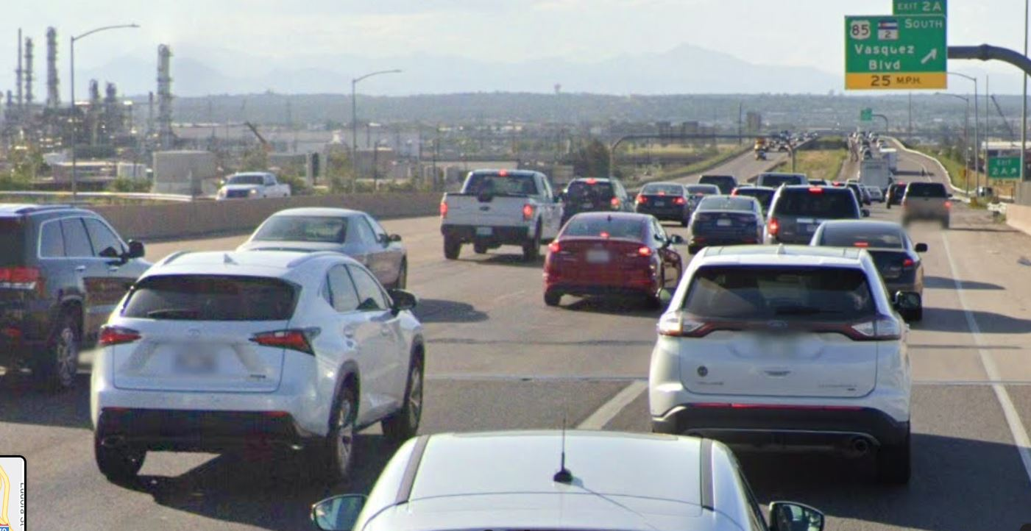
I-270 Corridor Improvements
Questions?

Slide 22
8:30 am – 9:15 am ​
The Future of Clean Mobility Presentation – Sophie Shulman, CDOT Office of Innovative Mobility​
Other​
Chair Mullica, on behalf of NATA, will send a letter to RTD supporting retention of FISA funds for the construction of unfinished FasTracks Corridors. ​

Slide 23
CDOT Clean Transportation

Slide 24
Defining Our Transportation Challenges
COLORADO COUNTIES IMPACTED BY AGING RESIDENTS AND TRANSIT NEEDS
POPULATION BOOM
CONGESTION & MOBILITY OPTIONS AIR QUALITY + PUBLIC HEALTH

Slide 25
Office of Innovative Mobility
Reduce pollution in our air and congestion on our roads by expanding multimodal transportation options, utilizing traditional and emerging mobility technologies.
Innovative Mobility
Transit & Rail
Mobility Services
Mobility Technology
Electrification

Slide 26
Mobility Technology
Develop strategy for piloting connected and autonomous vehicles in Colorado, including data collection and usage, as well as future policy recommendations
Lead Autonomous Mobility Task Force, with support from CSP and DOR
Explore ways to enhance existing mobility options through new technologies, such as ADAS for Bustang, autonomous attenuator, etc.

Slide 27
Electrification
Implementation of ZEV standard to ensure Coloradans have access to more models, such as pickup trucks, SUVs, and affordable EV options
Engage transit agencies to continue to transition to electric transit buses, including education and awareness around barriers and funding sources (including VW Settlement)
Support regional corridor charging networks through partnership with CEO and REV West MOU with neighboring states

Slide 28
Transit & Rail
Continue operational excellence and customer service to our local transit agencies, including support for medical transport, aging populations
Expand Bustang/Outrider to provide more connectivity across the State
Further develop and implement options for Front Range mobility, including development of “mobility hubs” and study Front Range Passenger Rail Feasibility

Slide 29
Mobility Services
Explore policies coming out of SB 19-239, Emerging Mobility Impacts Study, including examination of ridehailing, online delivery services, etc. and their impacts on the transportation system
Identify and launch efforts to support highly- effective transportation demand strategies to address congestion, including enhancing transit ridership through seamless payment integration
Continue to explore ways to better serve rural populations, veterans, older Americans, and other underserved populations through new and traditional technologies

Slide 30
Our new reality: travel is down to all destinations
_{39%} museums, libraries, and movie
theaters.
reduction of traffic to eateries,
cafes, shopping centers,
53%
reduction of traffic to transit and mobility stations.
Source: Google Mobility Changes Report - Colorado, US

Slide 31
Travel is down to all destinations
15%
increase of traffic to public
parks, gardens, dog parks, and
trails.
37%
reduction of traffic to places of work and offices.
Source: Google Mobility Changes Report - Colorado, US

Slide 32
Telecommuting Impacts
In March and April 2020, 86% of commuters worked remotely on any given workday, compared to only 6% in March 2019.
Source: Denver Regional Council of Governments

Slide 33
Most teleworkers are satisfied
Source: Denver Regional Council of Governments

Slide 34
Air Quality Impacts
CDPHE is evaluating NO2 , NO, SO2, CO, PM10, PM2.5 at multiple air quality monitors
Comparing March/April 2020 to January/February 2020 and March 2019
Initial results show significant drops in all pollutants evaluated
5 - 40% decreases for all pollutants
50%+ decrease for some instances of SO2

Slide 35
Traffic and time-saving impacts
197
The average time that could be saved annually by an employee in Boulder working from home instead of commuting (based on a 20% adoption rate).
hours
As we move forward from COVID-19 and crisis planning, using teleworking tools that are established in crisis can generate change for a business for the future.

Slide 36
How does this change our work going forward?
Encouraging clean transportation that aligns with public health goals
Uncertainty as to how public transit recovers/evolves in the next several months
Opportunity to encourage continued telework, active transportation, and electric vehicles
Lead by example – engage communities, employers to commit to sustainable transportation choices

Slide 37
Questions?

Slide 38
Agenda
Other
Chair Mullica, on behalf of NATA, will send a letter to RTD supporting retention of FISA funds for the construction of unfinished FasTracks Corridors.
Meetings will be held virtually until further notice due to COVID -19 concerns. Zoom link will be sent under separate email.
Next NATA Meeting is June 25

